Slide 1
Image auto searching
using Logitech Craft Keyboard
for Office
資電鐵三角

Slide 2

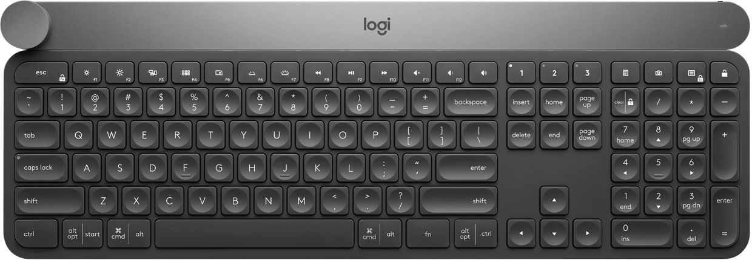
Example

Slide 3

Without our Application
Open a browser and search image.

Slide 4
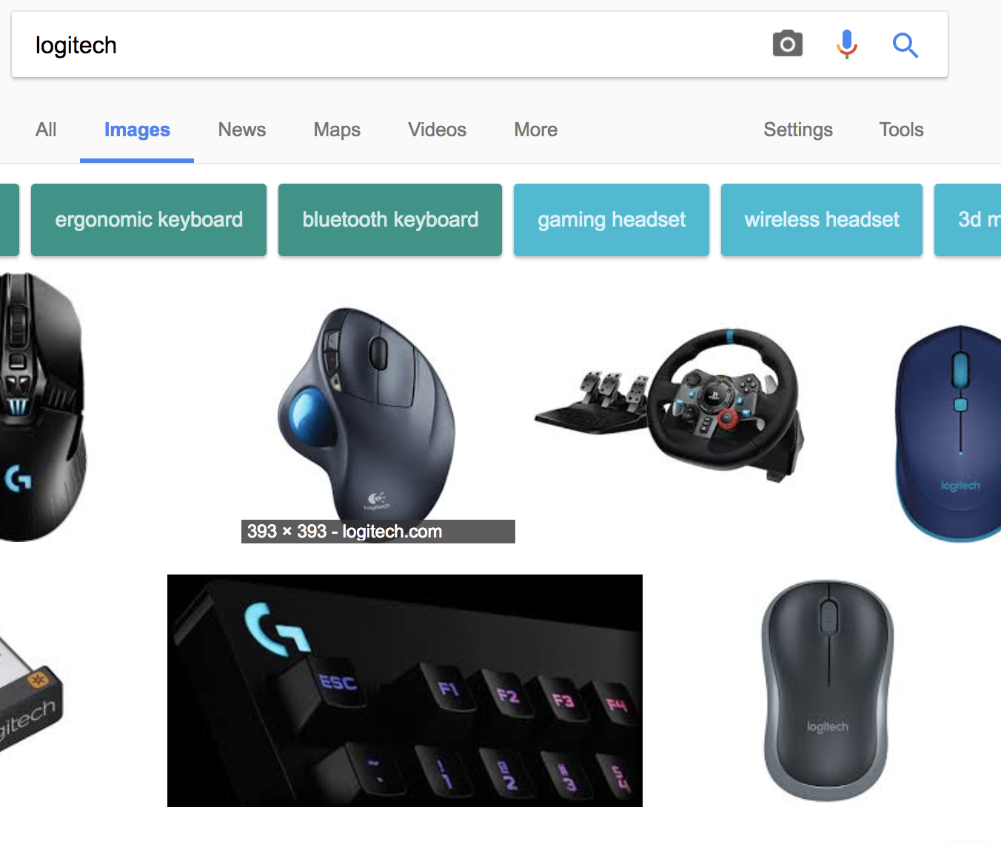
2. Choose an image.

Slide 5
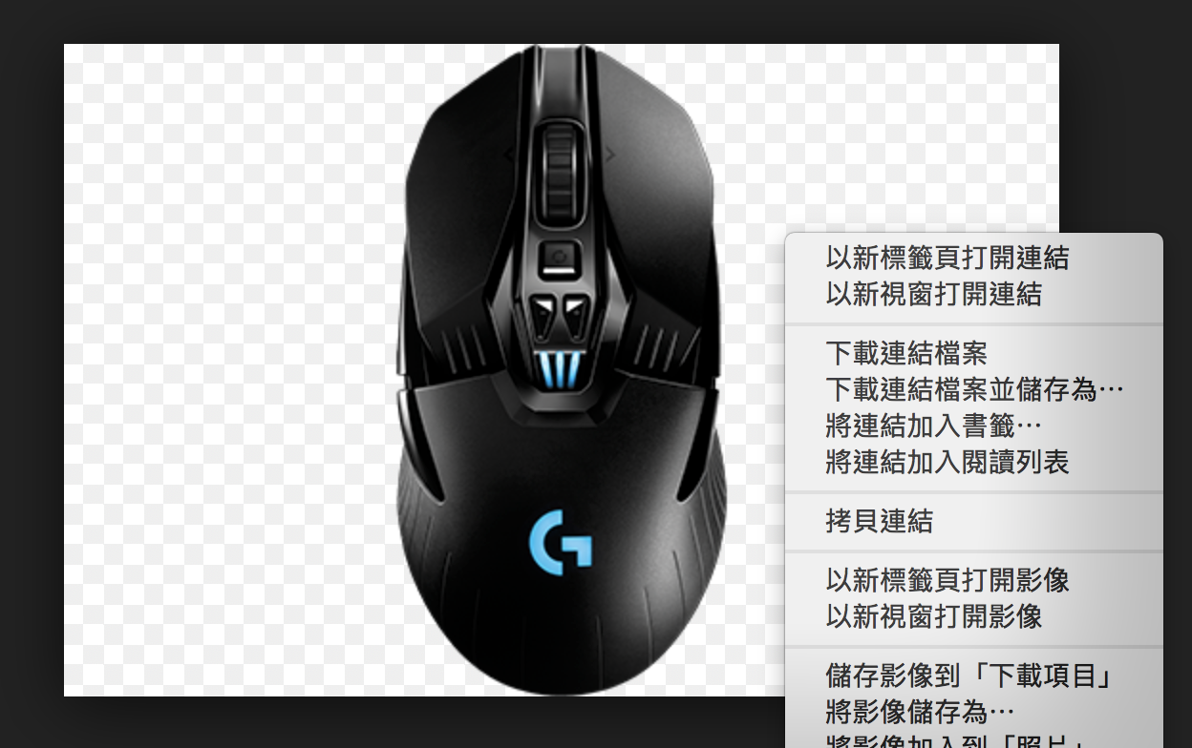
3. Save the image.

Slide 6
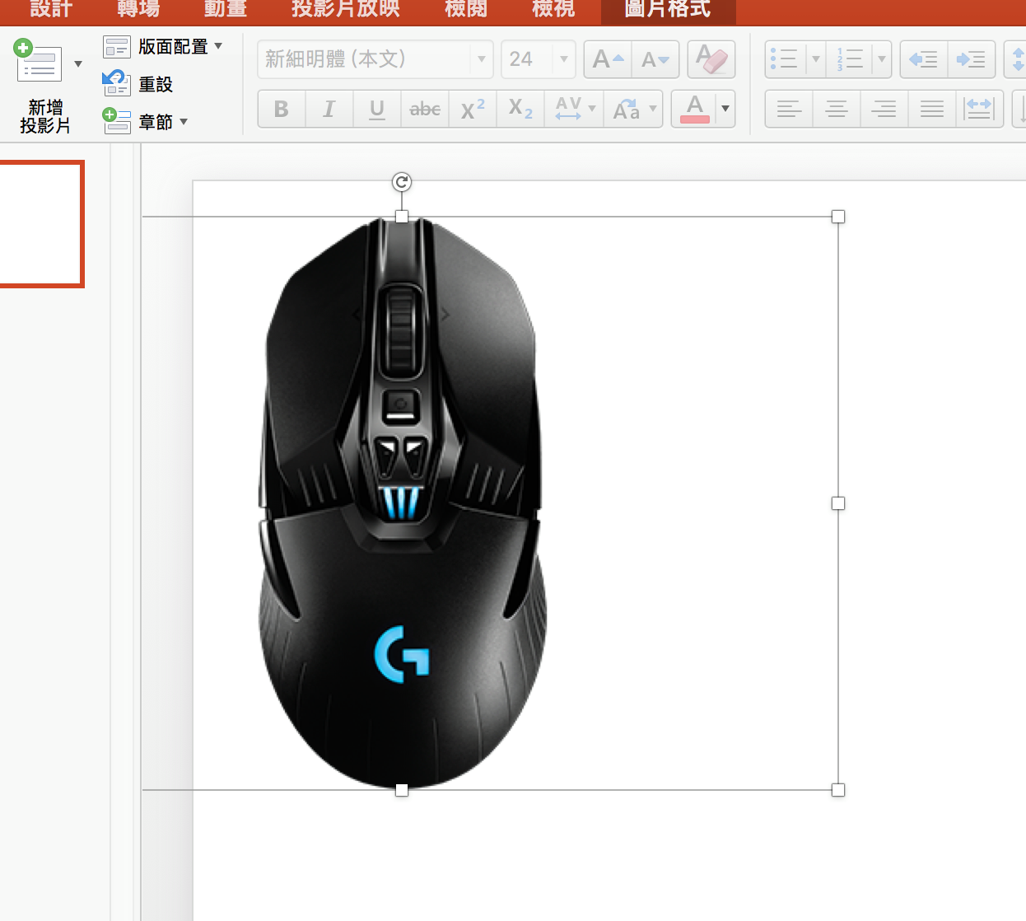
4. Paste on Office.

Slide 7
With our Application
Type keyword in where you want to insert an image.
Select the keyword and turn the dial, then choose an image.

Slide 8






Architecture
Crawler
send keyword
dial turning signal
Craft
Python Controller
Google image searching
receive images

Slide 9
Future Work
Insert image at mouse position. (PowerPoint or other slide apps)
Let image downloading be faster.
Integrate with Logitech Options.

